Slide 1
Modernizing Applications with Containers

Slide 3
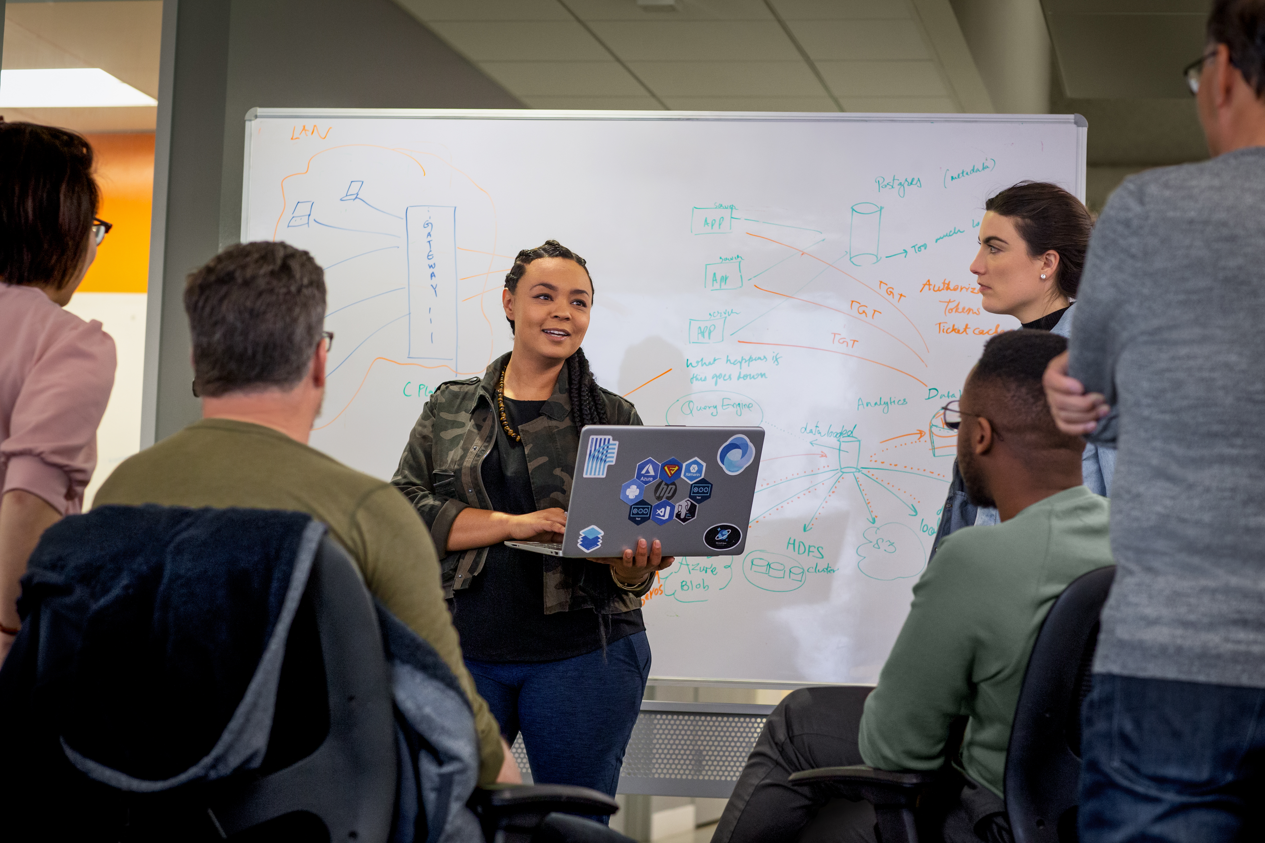
Day 1 Module 1: Introduction to Containers Module 2: Assessing the App and Environment for Containers Module 3: Building and testing a container locally Day 2 Module 4: Preparing for AKS Deployment Day 3 Module 5: Deploying the Application to AKS Module 6: Best Practices and Tips
Agenda

Slide 4
Module 1 - Introduction to Containers

Slide 5
Module 1: Objectives
Understand the benefits of containers
Learn what containers are
Understand how container hosts run containers
Understand how container images relate to containers
Understand container registries

Slide 6
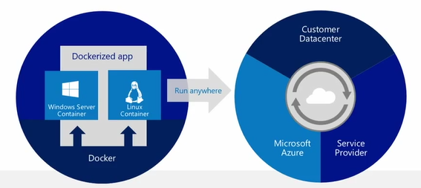
Why Containers?
Build any app in any language using any stack (OS)
Containerized apps can run anywhere on anything
No more “It works on my machine…”
No more dependency daemons so Developers and System Admins unite
Notes:
Container technology called Docker => other competitor like rkt (Rocket)
Package your system/component with all needed dependencies
Host independent -> no particular install on your host except Docker daemon/engine
If it works on my machine, it will work everywhere.
Inner loop debugging

Slide 7
Container Vocabulary
Host A VM running a daemon (ex. Docker) to host a collection of containers
Client Where container commands (ex. Azure CLI) are executed
Image An ordered collection of filesystems (layers) to be used when instancing a container (more on this later)
Container A runtime instance of a container image
Registry A collection of container images
Notes:
Host -> where the containers run (Docker daemon)
Client -> docker CLI
Image -> Definition of the container. Describing dependencies. Decomposed in Layers (see Dockerfile).
Container -> Instance of Image
Registry/repository -> Store and distribute images.

Slide 8
Challenges with Virtualization
Notes:
Left - Architecture of multi VM system => shared hardware, duplicated OS
OS duplicated – no value for business users (most of the time).
Running a Host is demanding : maintenance, resource, time to boot/scale/reproduce configuration

Slide 9
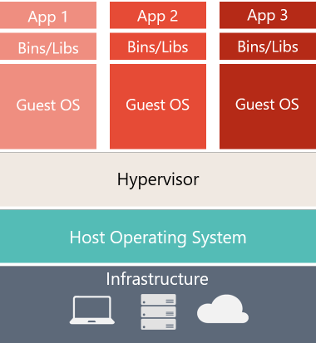
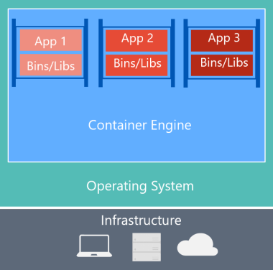
Virtual Machines versus Containers
Virtual Machine
Container
Notes:
Left: duplicated OS
Right: Container architecture:
-> Share the OS
-> Container layer => translate OS ⬄container interactions => runs on the host
-> From a host standpoint, containers are processes (managed by the docker engine) running in parallel
-> From a container standpoint, my application is running on an isolated machine: I have my own file system.

Slide 10
Virtual Machines vs. Containers
Applications traditionally built and deployed onto physical systems with 1:1 relationship
New applications often required new physical systems for isolation of resources
Package and run apps within
Containers
Physical
Physical/Virtual
Higher consolidation ratios and better utilization
Faster app deployment than in a traditional, physical environment
Apps deployed into VMs with high compatibility success
Apps benefited from key VM features i.e. Live migration, HA
Key Benefits
Further acceleration of app deployment
Reduce effort to deploy apps
Streamline development and testing
Lower costs associated with app deployment
Increase server consolidation
Virtual
Notes:
Evolution towards containers
Physical:
1 host for 1 app =>
Good isolation
Time to scale = buy new machine
Bad resource utilization (machines sit there doing nothing)
VM:
1 VM for 1 app =>
Better resource utilization
Isolation
Portability => duplicate VM
Dynamic scale out
Container:
1 app for 1 container =>
Better utilization => time to scale out
Portability (reproductive configuration => pet/cattle),
Inner loop => time to test decreases

Slide 11
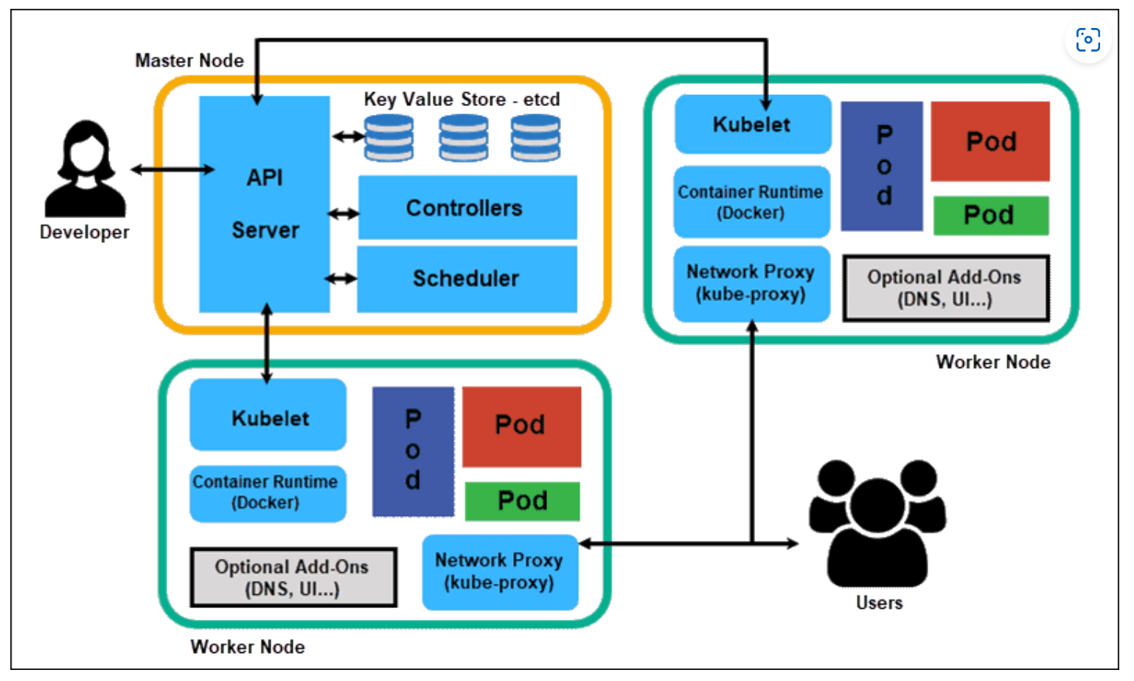
Azure Kubernetes Service Platform
The entire Kubernetes architecture revolves around the concept of the cluster. A cluster is a set of nodes, physical or virtual machines that perform various functions. Each cluster consists of:
The control plane running on a master node. There are usually multiple master nodes running in the cluster to avoid disruption and maintain high availability. However, only one is active at any time.
Worker nodes, running containerized applications in pods, which are the smallest Kubernetes execution units.
The control plane consists of multiple elements designed to maintain the cluster. These elements are:
kube-apiserver: the front-end control plane component that exposes the Kubernetes API. The most important feature of kube-apiserver is that it scales horizontally. It means that multiple instances of the component can exist simultaneously, balancing traffic and providing performance improvements.
etcd: the key-value store for cluster data.
kube-controller-manager: the component that runs controller processes, such as the node controller for node monitoring, the job controller that manages Kubernetes jobs, token controllers, etc.
kube Scheduler: the component that searches for the pods with no nodes assigned and provides them with nodes to run on.
Each node in Kubernetes consists of:
Container runtime, the software that runs containers, such as containerd, CRI-O, and other Kubernetes CRI implementations.
kubelet, the agent component that ensures containers are running and functioning properly.
kube-proxy, the network proxy element monitoring and maintaining network rules on the node.
Notes:
Let’s describe Docker platform:
Docker => industry standard
Engine ⬄ Daemon => runtime to run & manage container.
=> interact with the Linux Kernel
But you Cannot containerize everything -> example: usage of kernel related features (Windows registries).
Initially based on Linux OS with OS specific components (namespace, control group for isolation) => release in Dec 2013
Docker Hub => store your images online
Docker trusted registry => implement Docker Hub on premises

Slide 12
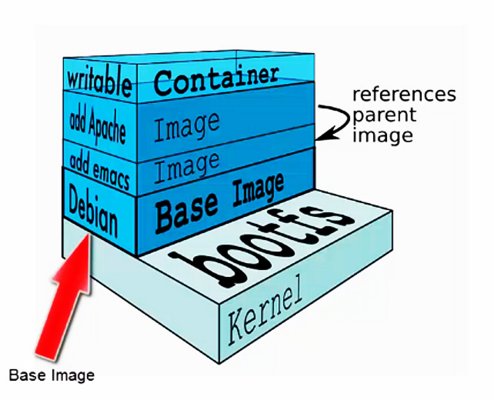
Container Images
A Docker image is built up from a series of layers.
Base platform OS image is provided by vendors like Microsoft for Windows OS image, Canonical for Ubuntu image etc.
Each layer represents an instruction in the image’s Dockerfile.
Each layer except the last one is read-only.
These images get published to DockerHub or Azure Container Registry (ACR).
Notes:
Docker images
Composed of Multi layers. Why?
Optimized for caching and sharing
Bottom layer = base OS.
Example of base OS:
alpine => very lightweight, not even a bash installed
Windows base OS => bigger than Linux base OS but it is decreasing
In Dockerfile (⬄Instructions to build your image) => 1 instruction = 1 layer.
Only top layer is writeable.

Slide 13
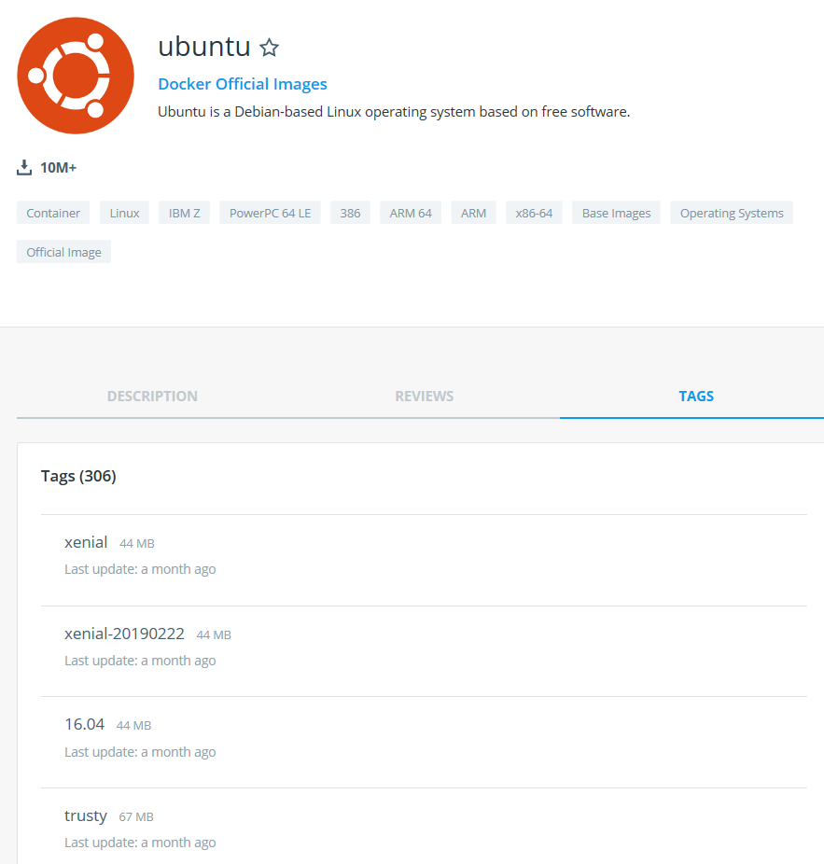
Image Tags
A Tag name is a string value that you can use to distinguish versions of your Docker images so you can preserve older copies or variants of a primary build.
You can group your images together using names and tags (if you don’t provide any tag default value of latest is assumed)
Notes:
Versioning
Opened/Flexible syntax => come up with your internal standard
Different approaches:
- Oracle => Version number
Ubuntu => version number or distribution name (xenial, trusty, devel, …)
ASP .NET Core runtime => runtime version + OS version
Runtime version
Note: Microsoft .Net images are now pulled from Microsoft Container Registry (MCR) even though they are still referenced on Docker Hub.
https://devblogs.microsoft.com/dotnet/net-core-container-images-now-published-to-microsoft-container-registry/

Slide 14
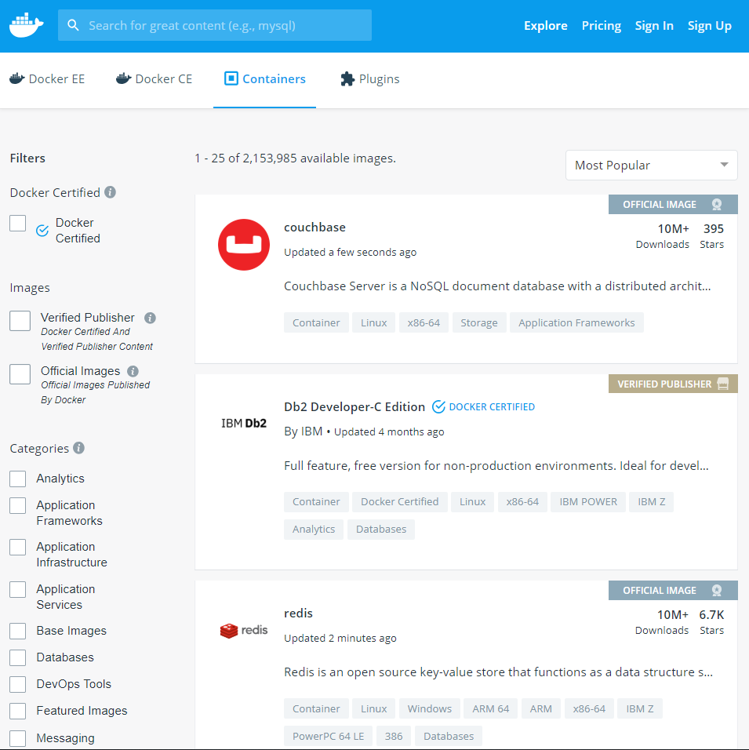
Container Registry
Stores docker images
Searchable
Public Registry – hub.docker.com
Docker Registry is open-source under the permissive Apache License
Private Registries – Instanced for you.
Example: Azure Container Registry
Automatic deployment for scaling out an app
Notes:
Docker registry
-> Repository of images
-> discoverable/searchable
Hub.docker.com
Azure Container Registry
Standard protocol to implement your own registry (the CLI can connect with it).

